Slide 1
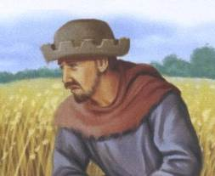

LO: to be able to explain why the Peasant's Revolt broke out.
1381:
The decisions of a Kentish villager
STARTER:
In three full sentences explain why the Peasants were unhappy in 1381

Slide 2
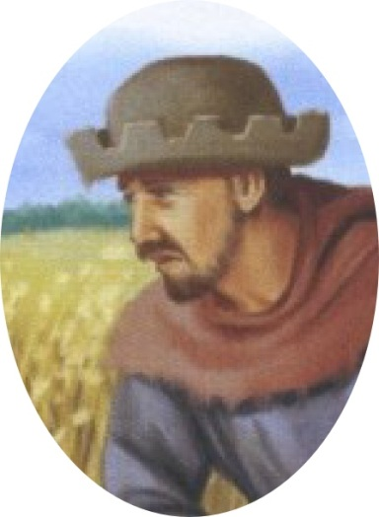
A Man of Importance
You are an important man in your village, trusted by the other villagers. This year they’ve chosen you as the constable, to protect the village from crime. Of course this is on top of your work, farming your land.
You own enough land and animals to feed your family. You also work 2 days a week on your lord’s land but he pays low wages, the same as in your grand-dad’s time. The law says you have to work for the same wages as 30 years ago.
Some villagers are even worse off. They’re villeins – they’re not free. They have to work for the lord for 2 days a week – for no pay. The law says that the lord can’t free them.
What is your job in the village?
How many days a week do you work on the Lord’s land?
How would you feel about being paid a low wage?
What affect would it have on your life?
What could people in your village do to try and change things?

Slide 4
LEARNING OUTCOMES
CORE: to be able to identify some of the key events of the peasants revolt
EXTENSION: to be able to comment on the types of people involved in the peasants revolt
KILLER: to be able to give some of the reasons behind the peasants revolt

Slide 5
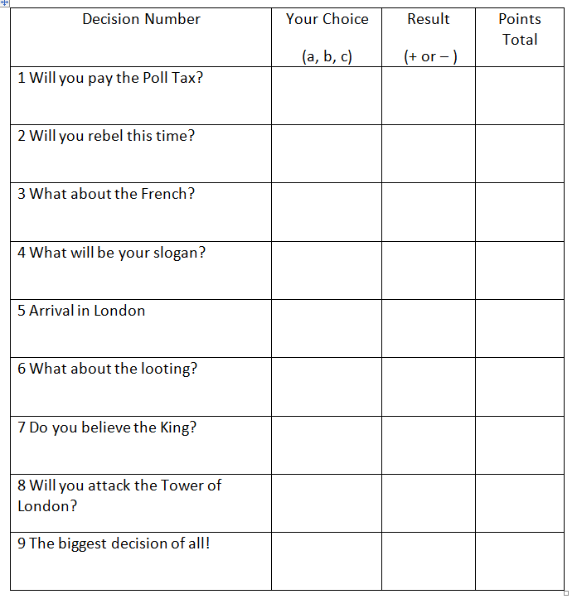
TASK
You are going to be given a series of situations.
You have to decide what you would do in each situation.
Make the right decision and you will gain points
Make the wrong decision and you will lose points.
Who will have the most at the end?

Slide 6

Decision 1: Will you pay the Poll Tax?
Tax collectors are visiting every village.
There’s lots of talk of people not paying the Poll Tax.
Will you:
  pay the tax – that’s 12 pence for you and 12 pence for our wife
  hide – the tax collectors will never find people in the woodland near the village
  rebel – attack the tax collectors to show the King’s advisers how angry everyone is.
YOU DECIDE

Slide 7
What did you decide?
a) pay the tax – lose 1 point. You’ve not done anything to improve your life and it’s cost you a lot of money.
b) hide – gain 1 point. You’ve saved a lot of money. Lots of people hid – as many as one in three in many areas.
c) rebel – lose 2 points. Dangerous! You don’t know if anyone else will rebel. Rebels are executed – very, very painfully! If only more people would protest!

Slide 8
Decision 2: Will you rebel this time?
The government is angry at how many people avoided paying tax by hiding. They’re sending more tax collectors to punish them – and collect the missing tax.
More news! Men in Essex have drowned a tax collector in the village pond. Rumours say a massive protest has started in Essex and in your county (Kent).
There’s a meeting in the village. People will listen to you.
Will you tell them to:
  pay the tax and accept the punishment. It may be best in the long run. If this protest doesn’t work you’ll all be punished.
  hide again – though the tax collectors are bringing soldiers with them.
  join the protest. It will be an adventure. You’ve never been to London. If this protest works, you’ll earn more and the villeins will be freed.
YOU DECIDE

Slide 9
What did you decide?
a) pay the tax – lose 1 point. You’ve not done anything to improve your life and it’s cost you a lot of money.
b) hide – lose 3 points. There’s not much chance of hiding this time and besides, you look a coward. Most of the villagers made choice c.
c) join the protest – gain 1 point. You’ve not paid the tax and you’ve stood up for what you believe in – but there’s a long way to go to be successful.

Slide 10

Decision 3: What about the French?
Someone in the village asks – should we leave men to defend Kent against a French attack?
Will you:
  Remember your responsibilities. You’ve been trained to lead the men of the village if the enemy land. So you select men to stay behind to guard against French attack.
  Ignore the French. Take everyone to London. It’s more important to attack the King’s advisers.
YOU DECIDE

Slide 11
What did you decide?
a) Select men to stay behind – good choice. Gain 1 point. You aren’t a rabble. You’re intelligent men and women.
b) Take everyone to London – bad choice. Lose 1 point. This makes you look like a selfish rabble.
What did happen?
In 1381 the men of Kent made choice (a). They used the system of ringing church bells to call out the local trained men to summon people to join the protest. They were well-organized and well-led – by people like you.

Slide 12
Decision 4: What will be your slogan?
The protest is growing.
The leader is Wat Tyler. He’s trying to make sure people know why they’re protesting.
Which of these slogans is best?
  “Down with the king and all lords”
  “For King Richard and the true loyal common people”
YOU DECIDE

Slide 13
What did you decide?
a) “Down with the king and all lords” – lose 4 points. This sounds like rebellion. Remember what happens to rebels – they’re hanged, taken down, their stomachs cut open and their heads cut off. You are NOT rebelling against the King. You’re protesting against his advisers.
b) “For King Richard and the true loyal common people” – good choice. Gain 1 point.
What did happen?
Slogan (b) was one of the slogans used in 1381.

Slide 14
Decision 5: Arrival in London
London! There’s thousands of you arriving from Kent, Essex and other counties but even so you original protesters are outnumbered. There’s all kinds of people joining in – criminals let out of prison, troublemakers, the London poor. It’s getting chaotic.
Will you:
  go home. It’s dangerous to stay. Everything could go wrong.
  stay and make sure the protest reaches the young King. It’s too important to give up now.
YOU DECIDE

Slide 15
What did you decide?
a) go home. Lose 1 point. After all the effort? You’ll still have to pay taxes!
b) stay and make sure the protest works. Gain 1 point. This protest is important. If you and your friends go then the troublemakers really will take over.

Slide 16

Decision 6: What about the looting?
You see the luxurious Savoy Palace of John of Gaunt – the King’s uncle and the most hated man in England. Gaunt’s away in the north but his palace is being looted. One man is stealing silver. Someone else is setting fire to the palace.
Will you:
  join in and grab what you can for yourself
  make sure Wat Tyler knows what’s going on so he stops the looting.
  go home – it’s all going too far. You never wanted looting and crime – you’re a constable!
YOU DECIDE

Slide 17
What did you decide?
a) join in. Not a good choice. Wat Tyler threw the looter into the flames! He says you are here for justice, not theft. Lose ALL your points!
b) make sure Wat Tyler knows what’s going on. Gain 2 points. The protest will only work if you stay organized.
c) go home. 0 points. The protest is still important but maybe you’re right by this time – things are getting out of hand.

Slide 18

Decision 7: Do you believe the king?
This is what you’ve been dreaming of. Wat Tyler meets King Richard – and he agrees to your demands.
He will set us free from our lords, allow us to earn as much as we wish and he will think again about the Poll Tax. Wat is no fool and wants a signed promise. The King says he will bring one tomorrow.
Will you:
  go along to watch and cheer
  insist that Wat increases your demands – to get rid of all lords for ever so that everyone is equal?
YOU DECIDE

Slide 19
What did you decide?
a) go along to watch and cheer – gain 1 point. You’ll be able to tell your grandchildren about the moment the protest succeeded.
b) insist on getting rid of all lords so that everyone is equal? – lose 3 points. A priest called John Ball has been telling people that there were no lords in the days of Adam and Eve. Some rebels agree but this wasn’t what you were protesting about. This would be rebellion. This will get everyone’s heads cut off.

Slide 20
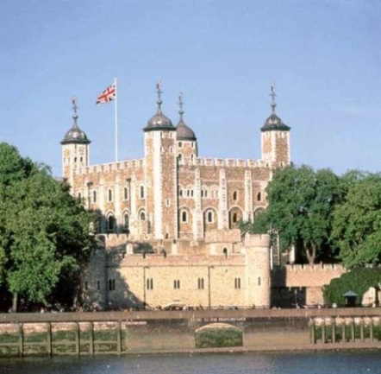
Decision 8: Will you attack the Tower of London?
You hear that the King’s hated advisers have fled to the Tower of London. They have few guards. You have thousands of men.
People in Kent particularly hate Simon Sudbury, the Archbishop of Canterbury because he’s been a very harsh landowner.
Will you:
  Join the mob attacking the Tower, take the King’s advisers prisoner and put them on trial in a court?
  Stay away from the Tower. This violence is frightening all the lords. They say you’re rebels and deserve death.
  Attack the Tower and murder the King’s advisers
YOU DECIDE

Slide 21

What did you decide?
a) put the King’s advisers on trial in a court. Gain 1 point. This shows you’re not a wild mob – but it wasn’t what happened!
b) Stay away from the Tower. 0 points. Probably a good idea for you but it won’t affect what happens in the future.
c) murder the King’s advisers. Lose 3 points. This will make sure the lords turn against you.
What did happen?
The mob attacked the Tower. Robert of Hales and Simon of Sudbury were beheaded and their heads were put on spikes on London Bridge.

Slide 22
Decision 9: The biggest decision of all!
Next day young King Richard II at the head of 60 knights and nobles meets Wat Tyler but a quarrel breaks out. You hear the Mayor of London call Wat Tyler a ‘base knave’ and strike him with his sword. Then a knight stabs Tyler. It seems as if Wat is dead.
The boy king rides forward and says:
  ‘Sirs, what is the matter? You shall have no other leader except me.
  I am your King. Be peaceful.’
He promises you will be granted all your demands if you go home peacefully.
Do you:
  shout ‘charge’ and attack the King and his men. You will kill them easily because they’re outnumbered. That’s the only way to get what you want.
  trust the king and go home? Surely the King won’t lie? This means all your efforts have been successful and you can go home to your children.
YOU DECIDE

Slide 23
What did you decide?
a) Shout ‘charge’ and attack the King. Lose ALL your points. You have attacked God’s chosen one. The King’s nobles will now do anything for revenge and will try to destroy you all.
b) trust the king? Lose 8 points. The King had lied.
What did happen?
None of your demands were granted. Once the protesters had gone home the King and new advisers organised a strong army. The ringleaders were hunted down and hanged by the roadsides.

Slide 24
EVALUATING YOUR RESULTS
Which result won you the most points? Why did you make that decision?
Which result lost you the most points? Why was that such a bad decision to make?

Slide 25
LEARNING OUTCOMES
CORE: to be able to identify some of the key events of the peasants revolt
EXTENSION: to be able to comment on the types of people involved in the peasants revolt
KILLER: to be able to give some of the reasons behind the peasants revolt

Slide 26
MINI-PLENARY: on your white boards.
What key events were part of the Peasant’s Revolt?
What people were involved in the Peasant’s Revolt?
What were the reasons behind the Peasant’s Revolt?

Slide 27
LEARNING OUTCOMES
CORE: to be able to identify some of the key events of the peasants revolt
EXTENSION: to be able to comment on the types of people involved in the peasants revolt
KILLER: to be able to give some of the reasons behind the peasants revolt

Slide 28
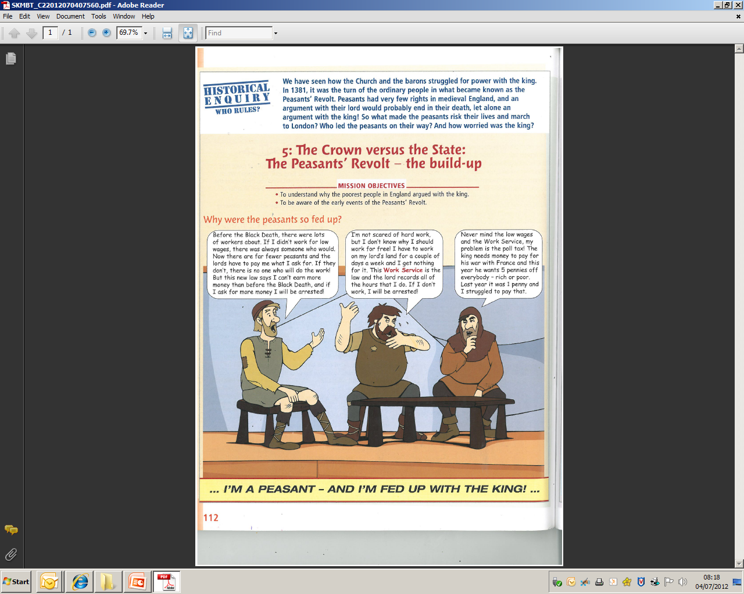
EMPATHY
IF YOU WERE A PEASANT INVOLVED:
HOW WOULD YOU FEEL AFTER THE PEASANTS REVOLT?
In full sentences copy and complete this speech bubble:
“After the peasants revolt I feel …”
CORE: two emotions about what happened and a reason for each.
EXTENSION: three emotions and a reason for each. Also say who you feel is responsible for the events
KILLER: three + emotions and reasons for each. Say who you feel is responsible and how you now feel about the original causes.

Slide 29
LEARNING OUTCOMES
CORE: to be able to identify some of the key events of the peasants revolt
EXTENSION: to be able to comment on the types of people involved in the peasants revolt
KILLER: to be able to give some of the reasons behind the peasants revolt

Slide 30
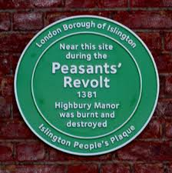
What should we remember 1381 for?
This plaque was put up in 2011.
Why do YOU think the events of 1381
should still be remembered?
Explain your answer fully.
I think that the events of 1381
should/ should not be remembered because…

